Slide 1

Byte Waste Solutions
Ben Lyon, Logan Brooks, Michael McFarland, Walter Lovett

Slide 2

Cleanup
We replaced N/A’s in Trash Hauler, and Trash Route
Made the Trash Hauler company names all capitalized
Counted all of the missed counts
Cleaned up float to integer ZIP Code
Cleaned a recurring S in Trash Route at the end of some data (ex: 2303S -> 2303)

Slide 3
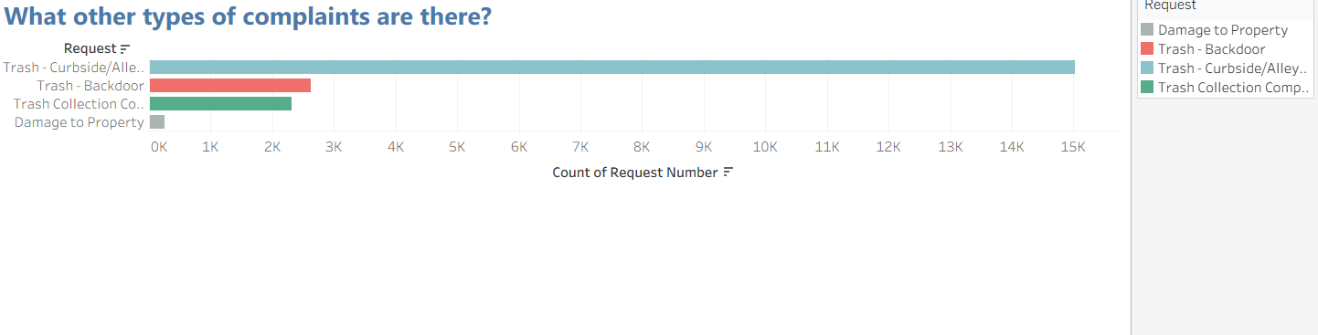

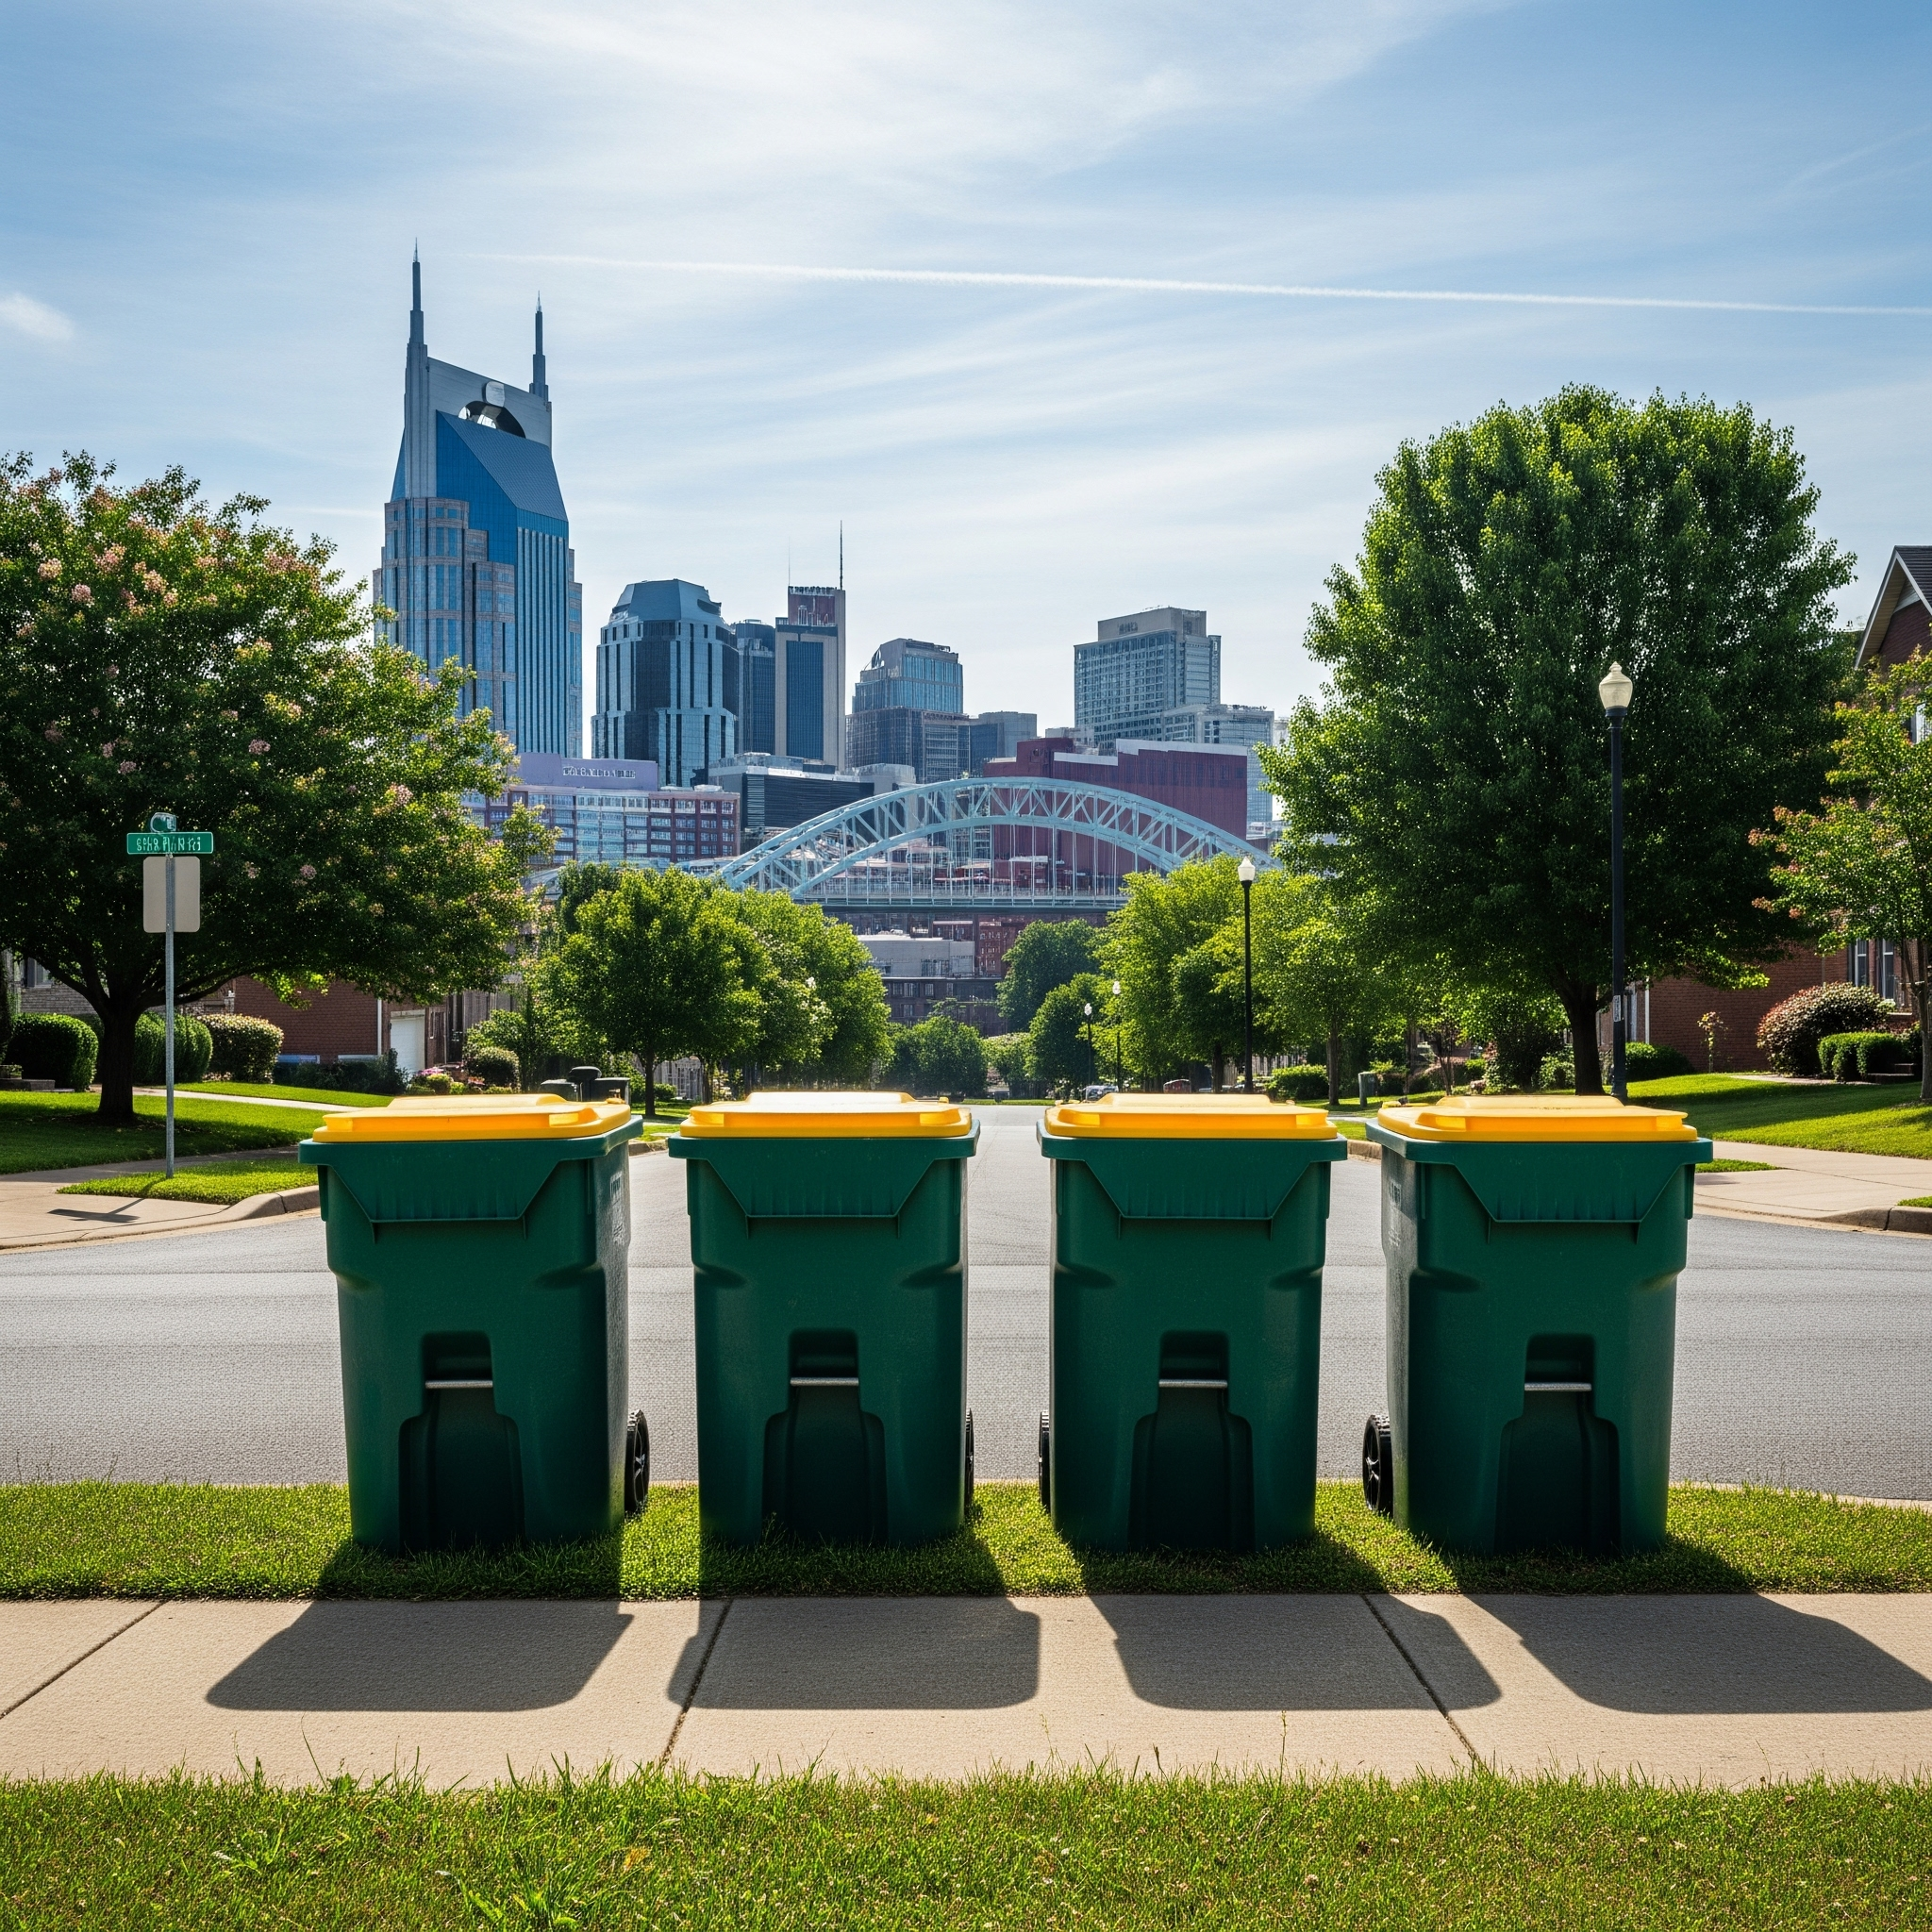
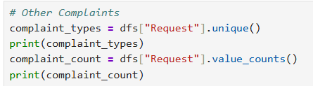
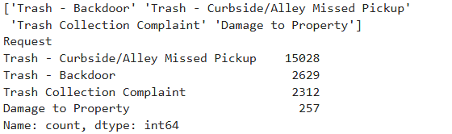

Slide 4
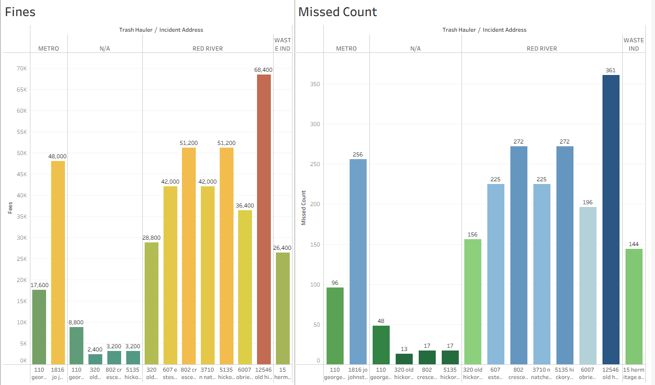

Slide 5
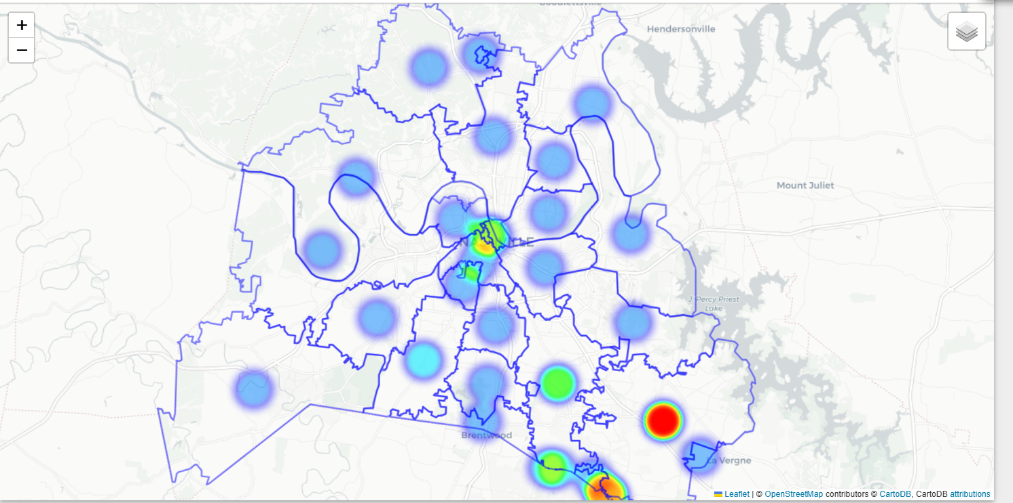
Heatmap

Slide 6
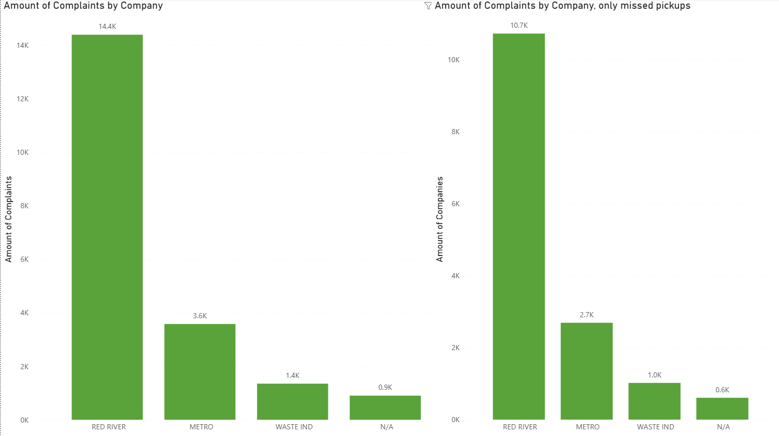
Metro crews compare to contractors performance

Slide 7
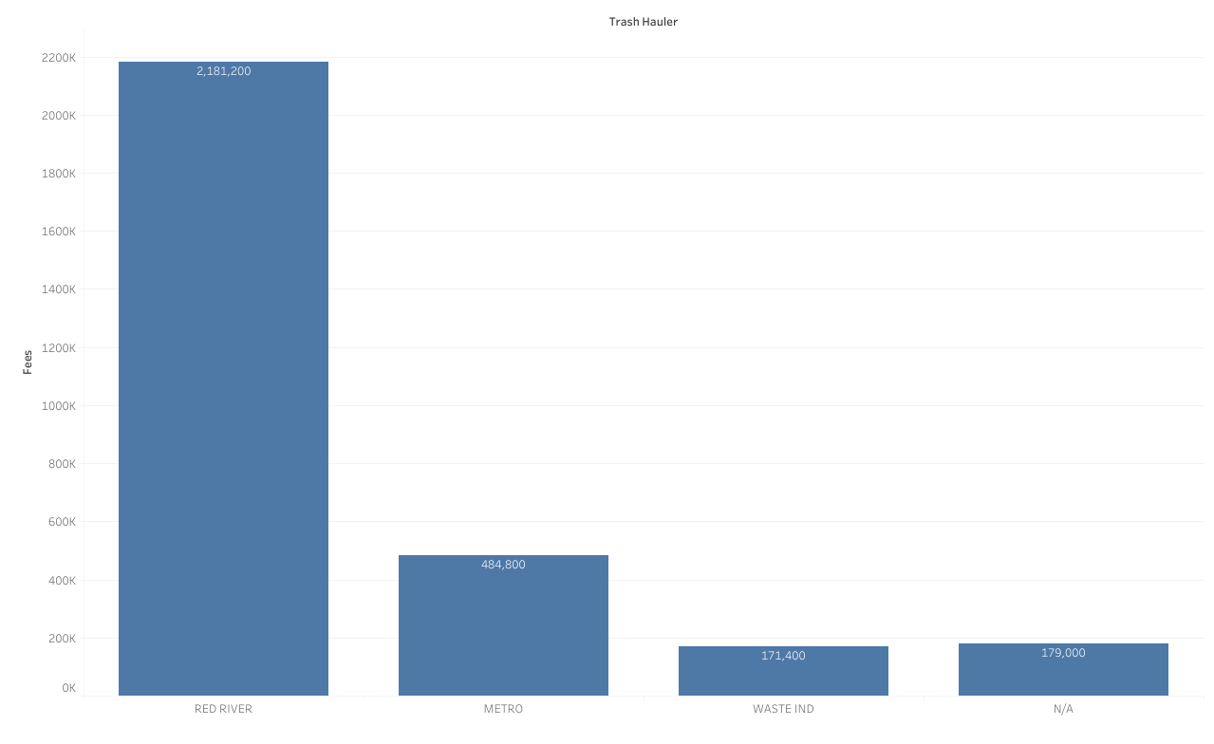
How much does each trash hauler owe
Notes:
Red river has 15k missed pickups, metro has 3.5k, waste ind has a measly 1253

Slide 8
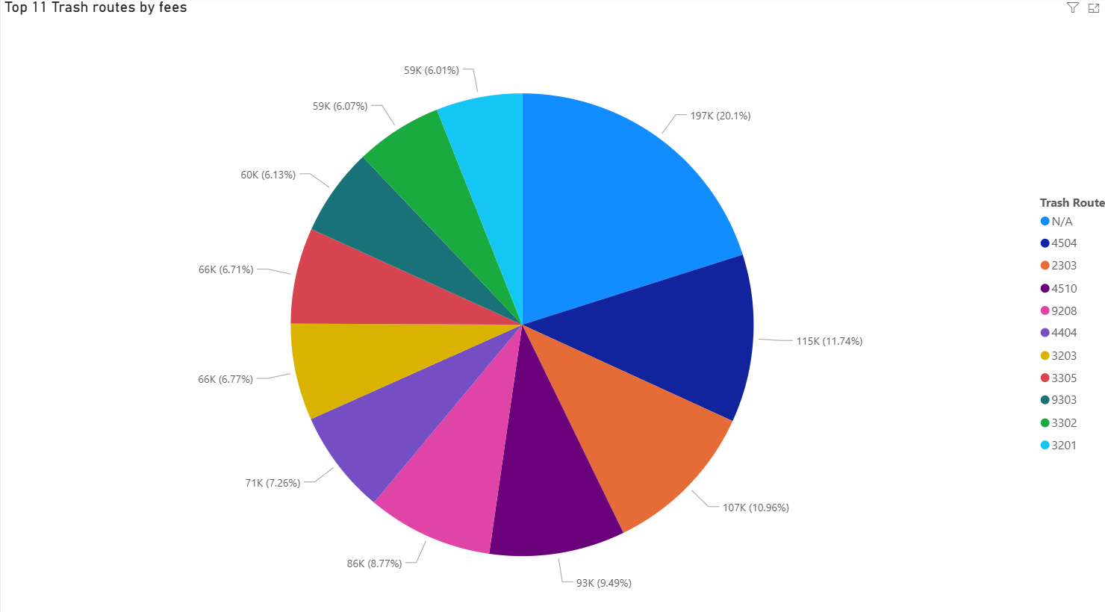
What were the total missed pickup by route?

